Slide 1
第十一章
网络地址转换

Slide 2
为什么要用NAT
公网IP地址数量不够用
安全的需要
合并两个有相同网络地址的网络
更换了ISP

Slide 3
网络地址转换的类型
静态NAT
动态NAT
PAT

Slide 4
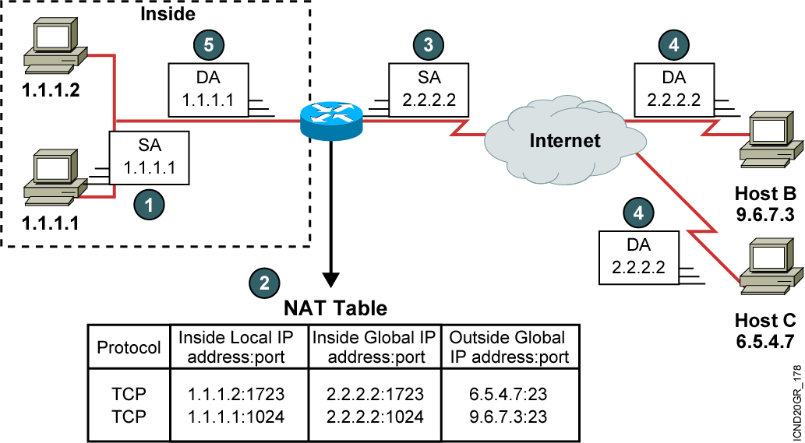
NAT的命名
NAT术语

Slide 5
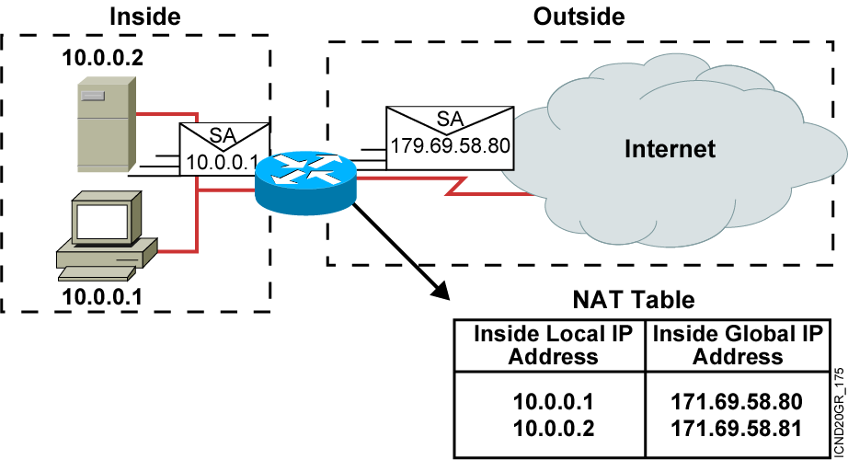
网络地址转换(NAT)的类型
静态NAT
内部本地地址与内部全局地址一一对应

Slide 6
动态NAT
地址池：171.69.58.80~85
内部地址：10.0.0.1~126
非一一对应

Slide 7
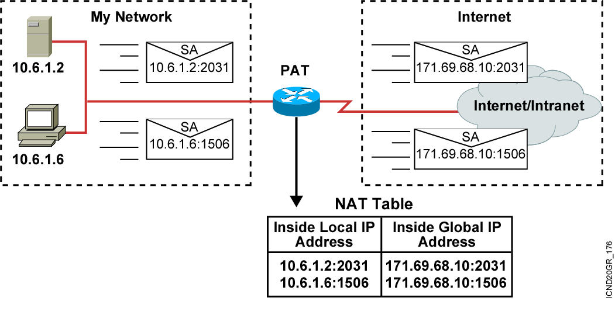
Port Address Translation(PAT)
多对一，使用端口标识不同终端
内部本地地址段：10.6.1.2~126
内部全局地址：171.69.68.10

Slide 8
NAT的配置步骤
表明内部外部接口
配置访问控制列表
配置地址池
配置NAT
配置默认路由

Slide 9
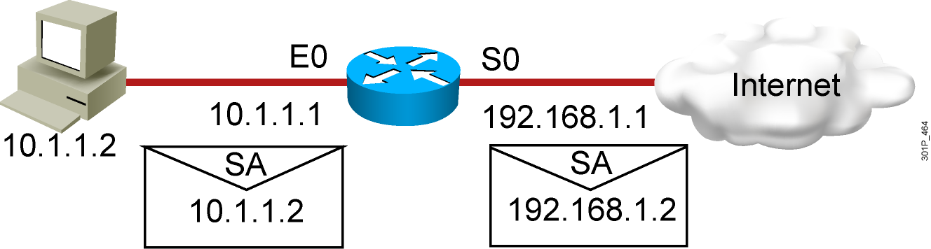
静态NAT配置
interface s0
ip address 192.168.1.1 255.255.255.0
ip nat outside
!
interface e0
ip address 10.1.1.1 255.255.255.0
ip nat inside
!
ip nat inside source static 10.1.1.2 192.168.1.2
RouterX# show ip nat translations
Pro Inside global Inside local Outside local Outside global
--- 192.168.1.2 10.1.1.2 --- ---

Slide 10
动态NAT配置方法
Router(config)#interface fa 0/0 内部接口
Router(config-if)#ip nat inside
Router(config)#interface fa 0/1 外部接口
Router(config-if)#ip nat outside
Router(config)#access-list 1 permit 192.168.0.0 0.0.0.255
Router(config)#ip nat pool zhengda 210.43.32.1 210.43.32.8
netmask 255.255.255.0
Router(config)#ip nat inside source list 1 pool zhengda [overload]
Router(config)#ip route 0.0.0.0 0.0.0.0 210.43.32.254

Slide 11
PAT配置方法
Router(config)#interface fa 0/0 内部接口
Router(config-if)#ip nat inside
Router(config)#interface fa 0/1 外部接口
Router(config-if)#ip nat outside
Router(config)#access-list 1 permit 192.168.0.0 0.0.0.255
Router(config)#ip nat pool zhengda 210.43.32.1 210.43.32.1
netmask 255.255.255.0
Router(config)#ip nat inside source list 1 pool zhengda overload
Router(config)#ip nat inside source list 1 interface fa 0/1 overload
Router(config)#ip route 0.0.0.0 0.0.0.0 210.43.32.254

Slide 12
NAT调试
Basic IP address translation
Router#show ip nat trans
Pro Inside global Inside local Outside local Outside global
--- 192.2.2.1 10.1.1.1 --- ---
--- 192.2.2.2 10.1.1.2 --- ---
IP address translation with overloading
Router#sh ip nat trans
Pro Inside global Inside local Outside local Outside global
tcp 192.2.2.1:11003 10.1.1.1:11003 172.16.2.2:23 172.16.2.2:23
tcp 192.2.2.1:1067 10.1.1.2:1067 172.16.2.3:23 172.16.2.3:23
Unique TCP port numbers are used to distinguish
between hosts.
A translation for a Telnet is still active.
Two different inside hosts appear on the outside with a single IP address.

Slide 13
Clearing NAT Translation Entries
Router#sh ip nat trans
Pro Inside global Inside local Outside local Outside global
tcp 192.16.2.1:11003 10.1.1.1:11003 172.16.2.2:23 172.16.2.2:23
tcp 192.16.2.1:1067 10.1.1.2:1067 172.16.2.3:23 172.16.2.3:23
router#clear ip nat trans *
router#
router#show ip nat trans
All entries are cleared.
router#show ip nat trans
Pro Inside global Inside local Outside local Outside global
udp 192.16.2.2:1220 10.1.1.2:1120 171.69.2.132:53 171.69.2.132:53
tcp 192.16.2.1:11003 10.1.1.1:11003 172.16.2.2:23 172.16.2.2:23
tcp 192.16.2.1:1067 10.1.1.1:1067 172.16.2.3:23 172.16.2.3:23
router#clear ip nat trans udp inside 192.16.2.2 10.1.1.2 1220
171.69.2.132 53 171.69.2.132 53
router#show ip nat trans
Pro Inside global Inside local Outside local Outside global
tcp 192.16.2.1:11003 10.1.1.1:11003 172.16.2.2:23 172.16.2.2:23
tcp 192.16.2.1:1067 10.1.1.3:1067 172.16.2.3:23 172.16.2.3:23
192.16.2.2 is cleared.

Slide 14
NAT调试
Router#debug ip nat
NAT: s=10.1.1.1->192.16.2.1, d=172.166.2.2 [0]
NAT*: s=172.166.2.2, d=192.16.2.1->10.1.1.1 [0]
NAT: s=10.1.1.1->192.16.2.1, d=172.166.2.2 [1]
NAT: s=10.1.1.1->192.16.2.1, d=172.166.2.2 [2]
NAT: s=10.1.1.1->192.16.2.1, d=172.166.2.2 [3]
NAT*: s=172.166.2.2, d=192.16.2.1->10.1.1.1 [1]
NAT: s=10.1.1.1->192.16.2.1, d=172.166.2.2 [4]
NAT: s=10.1.1.1->192.16.2.1, d=172.166.2.2 [5]
NAT: s=10.1.1.1->192.16.2.1, d=172.166.2.2 [6]
NAT*: s=172.166.2.2, d=192.16.2.1->10.1.1.1 [2]
An example address translation inside-to-outside.
A reply to the packet sent.
An example TCP conversation, inside-to-outside.
* Indicates translation was in the fast path.

Slide 15
端口映射
ip nat inside source static tcp (inside local port )(inside global port)

Slide 16
结束

